Slide 1
SMT M.M.P SHAH WOMEN’S COKLLEGE OF ARTS & COMMERCE
PPT ON:
DIGITAL MARKETING
By,
Rakhi Savita
SyBcom

Slide 2
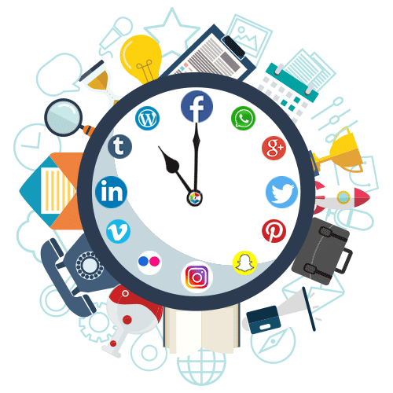
INTRODUCTION TO DIGITAL MARKETING
Digital marketing being a comparatively newer field,
many individuals are curious to know about it as they are not aware.
In simple terms, digital marketing can be called as the process of promoting brands or products using the electronic media. It mainly takes place on the Internet. Other platforms include mobile phones, digital displays and any other digital medium. As the name suggests, it makes use of the digital technologies.

Slide 3
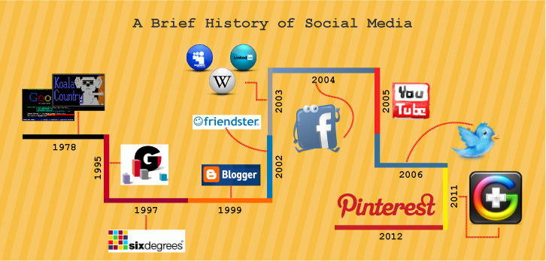
INTRODUCTION TO SOCIAL MEDIA MARKETING
What is social media?
Social media are interactive computer mediated technologies that facilitate the creation and sharing of information ideas, career interests and other forms of expression via virtual communities and networks. The variety of stand-alone and built-in social media services currently available introduces challenges.
HISTORY

Slide 4
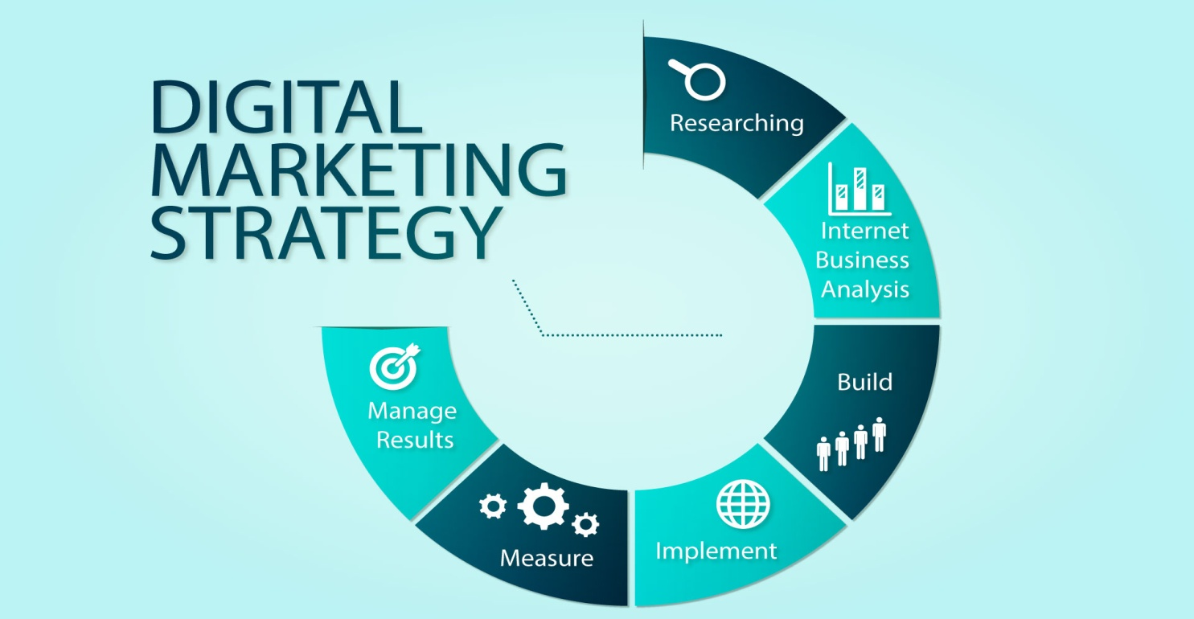
IMPORTANCE
Digital marketing is so important. The importance of digital marketing works not only in favor of marketers, it provides something innovative to the consumers too. Let us have a look and understand the importance of digital marketing.
Opens up growth options for small businesses
Customer support has become a priority
Get connected to the Mobile Customers
Increase the trust for your Brand
STRATEGY

Slide 5
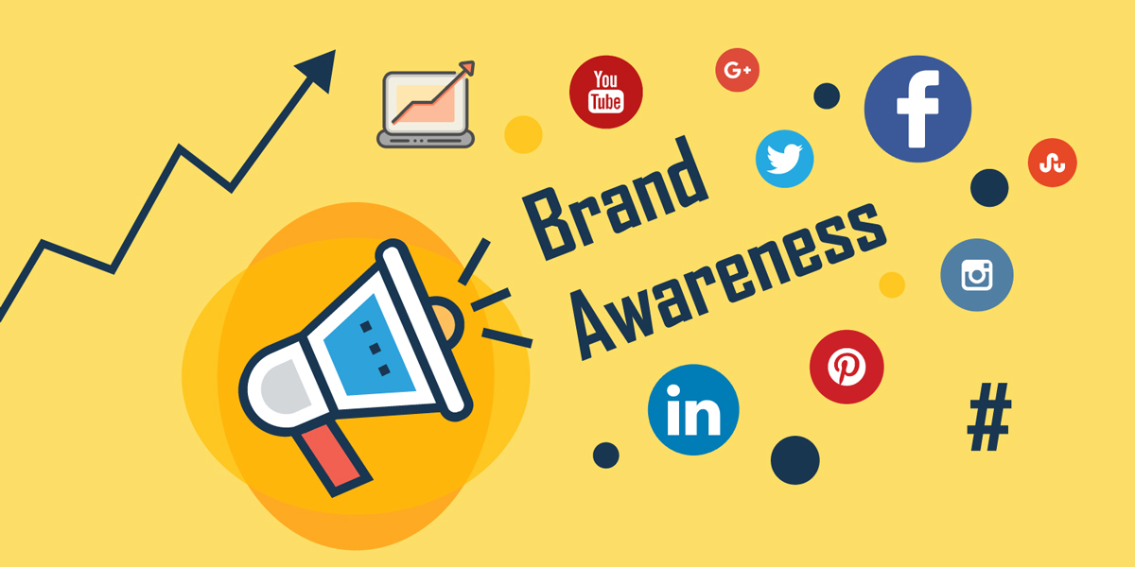
BUSINESS PROFILE/MARKETING
A business profile represents the face of your company. A well presented and optimised profile establishes brand identity, inspires trust, encourages customers and creates a memorable impact.
It is also your chance to publically establish your company’s unique selling points and generate positive perceptions of your products and services.
Businesses are increasingly using social networking platforms such as Facebook and Twitter to establish their corporate image online, and also to interact with their customers and competitors too.

Slide 6
FACEBOOK
WHAT IS FACEBOOK MARKETING?

Slide 7
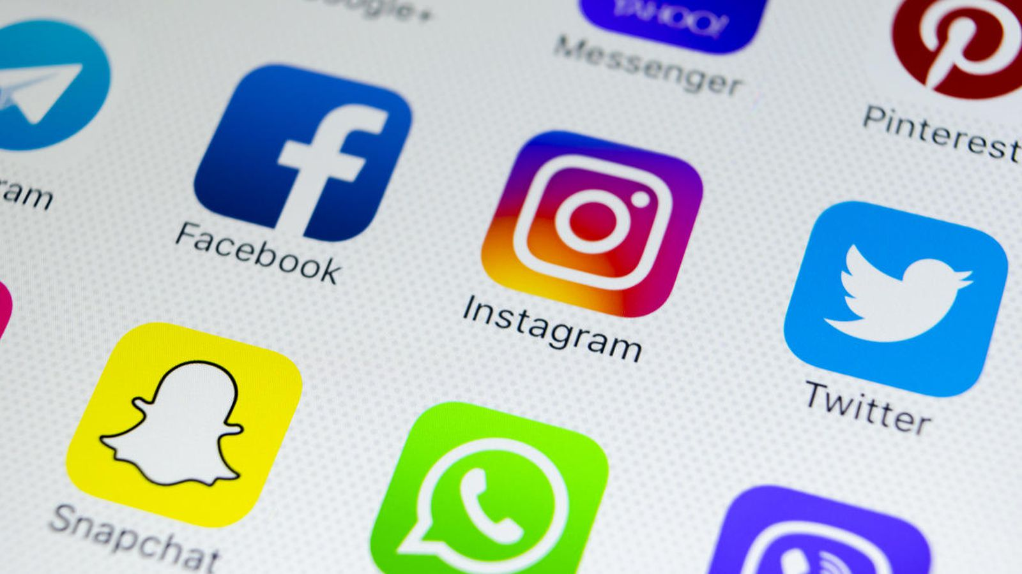
GROW YOUR BUSINESS WITH FACEBOOK As the go-to marketing platform for business, however, means that you will have hundreds and thousands of rivals on facebook. To guarantee that you are reaching as many of your target audiences as possible and your revenue stream will continue to grow despite your competition, you will have to use facebook marketing strategies such as the following:
1. Use a Personal Profile for Business Promotion
2. Comment on Popular Facebook Business Pages
3. Start a Group
4. If you have the budget, Create Ads for Your Page
5. Make Notes
6. Start Facebook Events
7. Utilize Apps
FACEBOOK APPS

Slide 8
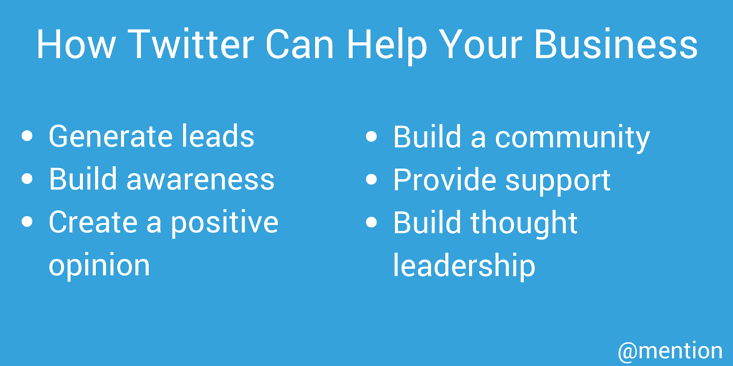
TWITTER
WHAT IS TWITTER MARKETING?
With over 313 million monthly active users and a young demographic to boot, Twitter is a great platform for most marketers.
Starting up a Twitter page for your company is easy. Anyone can come up with a Twitter handle, upload their profile photo, fill and send out their first Tweet. What’s not so simple, however, is growing your Twitter account and turning it into an actual tool that generates leads and builds up your brand.

Slide 9
WHAT IS HASH TAG?
To social media, the hashtag is used to draw attention, to organize, and to promote.
Hashtags got their start in Twitter as a way of making it easier for people to find, follow, and contribute to a conversation. Archeologists have unearthed this early tweet, and believe it to be the first time the hashtag was used for this purpose.
TWITTER API
Twitter is what’s happening in the world and what people are talking about right now. You can access Twitter via the web or your mobile device. To share information on Twitter as widely as possible, we also provide companies, developers, and users with programmatic access to Twitter data through our APIs (application programming interfaces). This article explains what Twitter’s APIs are, what information is made available through them, and some of the protections Twitter has in place for their use.

Slide 10
LINKEDIN
LINKEDIN MARKETING
You want to generating leads, build brand awareness, or establish strategic partnerships, LinkedIn can connect your brand with more than 450 million professionals across the globe.
1. Start with Your Own LinkedIn Profile
2. Create an Effective LinkedIn Company Page
3. Define Your Audience and Goals
4. Optimize Your Company Page for Search
5. Add Company Page Followers
6. Use Rich Media to Increase Company Page Engagement
7. Create LinkedIn Ad Campaigns to Drive Your Marketing Goals

Slide 11
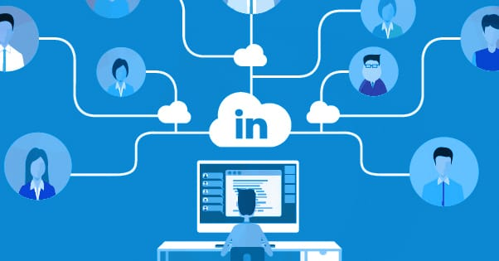
PROMOTION &CONNECTING CUSTOMERS

Slide 12
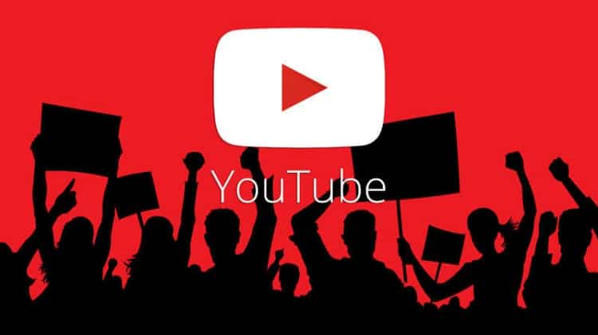
YOUTUBE
YOUTUBE
YouTube allows users to upload, view, rate, share, add to playlists, report, comment on videos, and subscribe to other users. It offers a wide variety of user generated and corporate media videos. Available content includes video clips, TV show clips, music videos, short and documentary films, audio recordings, movie trailers, live streams, and other content such as video blogging, short original videos, and educational videos. Most of the content on YouTube is uploaded by individuals, but media corporations

Slide 13
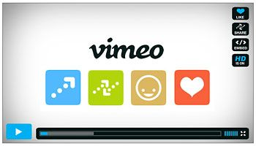
VIMEO
DAILYMOTION
Dailymotion is a video-sharing technology platform. Dailymotion is available worldwide in 18 languages and 35 localised versions featuring local home pages and local content. It has more than 300 million unique monthly users

Slide 14
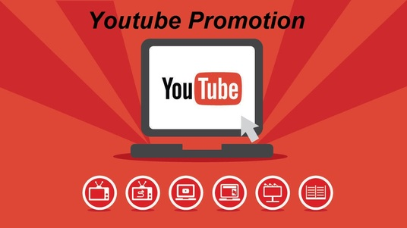
PROMOTION

Slide 15
BLOGGING FUNDAMENTALS
BLOGGING
Blogging first started as a way to have an online personal web log, in which a person would journal about their day. From "web log" came the term "blog”.

Slide 16
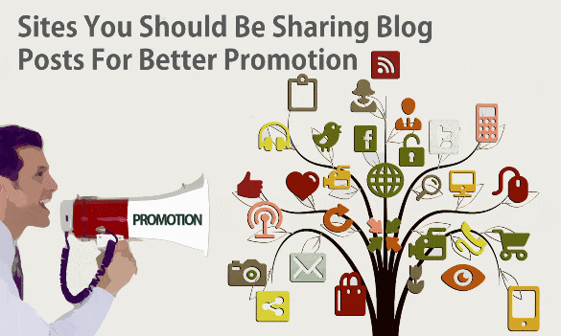
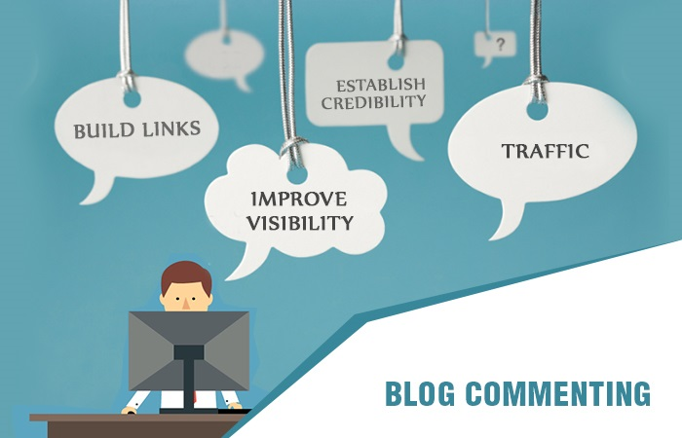
BLOG PROMOTION
BLOG COMMENTING

Slide 17
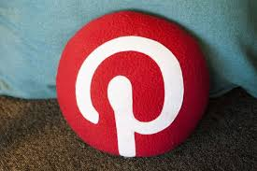
PINTEREST MARKETING
WHAT IS PINTEREST?
Pinterest is social media network that allows users to share images associated with project, goods, and services, and to visually discover new interests by browsing images others have posted.
Pinterest is also a social network. Users interact with each other through liking, commenting, re-saving each other’s stuff an Pinterest is also a social network.

Slide 18
HISTORY OF PINTEREST
]

Slide 19
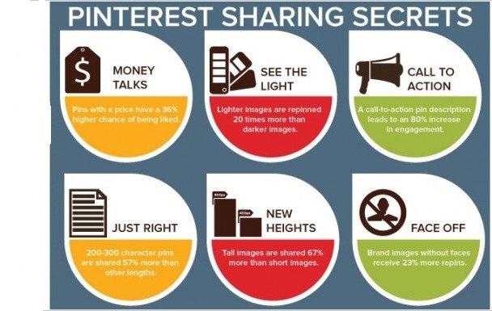
INTERESTING FACTS

Slide 20
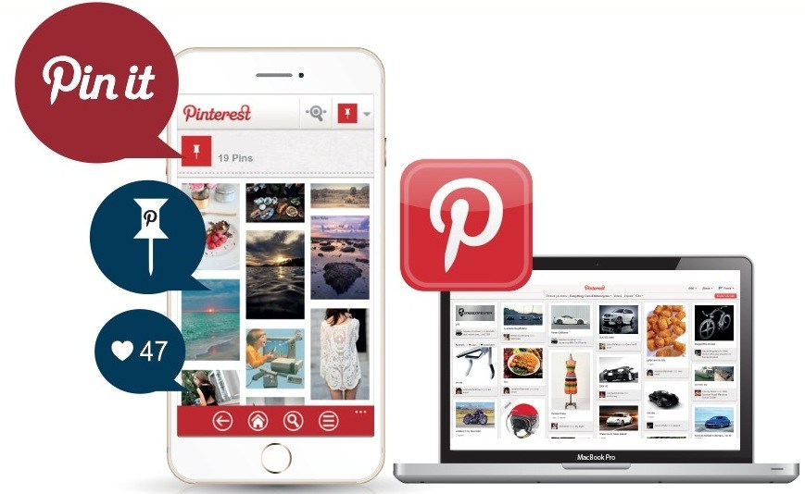
PROMOTING BUSINESS & STRATEGIES FOR DIGITAL MARKETING EASE OF MARKETING
1: Get to Know Pinterest
2: Create Some Boards
3: Create Compelling Content for Each Step of the Pinners’ Journey
4: Promote Your Highest-Performing Pins
5: Start Pinning!

Slide 21
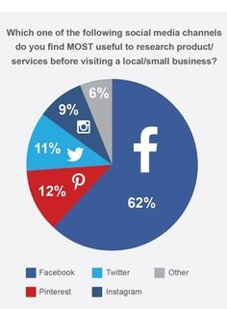
PINTEREST VS. OTHER SOCIAL MEDIA

Slide 22
GOOGLE+ MARKETING
CREATING A BUSINESS PAGE ON GOOGLE+ Google+ Pages, pages specifically engineered for businesses on Google+. While Google indicated that Google+ Pages wouldn't be immediately accessible to all, it looks like they're actually becoming readily available.
Steps to create a Google+ Page for your business.
1. Choose an Accessible Gmail Account
2. Create a Page with the Desired Account
3. Customize Your Public Profile
4. Promote Your Page

Slide 23
GOOLGE+ TOOLS
To make the process fast, you should use some cool Google+ tools. These tools will help you provide some detailed information about your profile and will help you build connections with other people on Google+.
Circloscope is a simple circle management tool for Google+ that will build circles based on relevant people you should connect with.
Circlecount tool gives you a detailed analysis of your Google+ profile. You can view details like your top posts, profile engagement, and profile growth history.
AllMyPlus will give you all the statistics of your Google+ profile. It will give the most popular posts you shared, top locations and charts showing your posting behavior.
Recommended User lists the top users in every industry to connect with. You can find the top followed people in any industry.

Slide 24
SOCIAL BOOKMARKING
BENEFITS IF BEING REGISTERED IN BOOKING MARKING SITE
Social Bookmarking is nothing but an online portal which enables users to share, add, and edit different web documents. Every individual spends a large portion of their day online and when you read something interesting that you want to share with your friends and family, you bookmark it and save it online. It’s as simple as adding a bookmark in a book. Social Bookmarking allows the user to return to the page later and access it from different sources since it is available online.

Slide 25
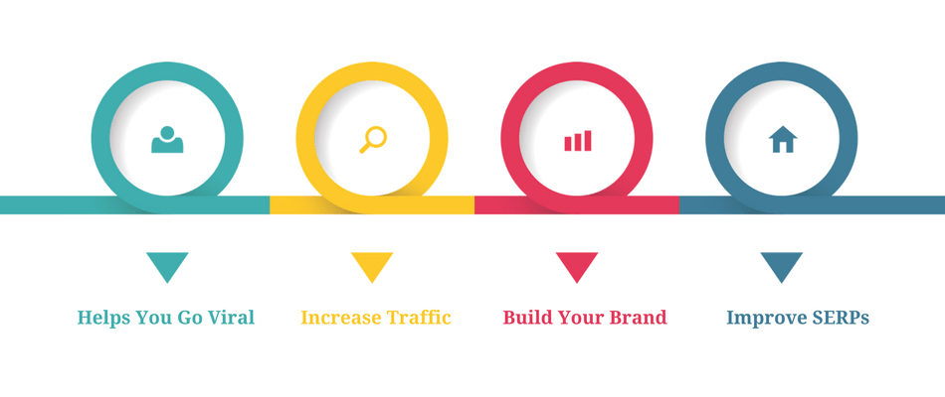
ADVANTAGES OF BOOKMARKING
HELPS YOU GO VIRAL
Social Bookmarking comes in when you make post a link of your blog post as a bookmark on different Social Bookmarking sites, the users will automatically be redirected to your blog when they view the same. Once you interest the new visitors with your blog, they will automatically bookmark your posts on different social media sites.

Slide 26
INCREASE TRAFFIC
Once your blog goes viral on the social media thanks to Social Bookmarking, you will see an increase in traffic. Make sure that you don’t stop at posting your bookmarks on one site. Post on multiple sites to increase the inflow of traffic.
BUILD YOUR BRAND
With Social Bookmarking, you get targeted traffic. When you get the targeted customers, you automatically help your brand grow. Once the new users find your blog appealing, they will subscribe to it. Social Bookmarking sites often allow users to review the different sites.
IMPROVE SERPS
Social Bookmarking is a convenient way to build one-way links. Bookmarking sites have a positive impact on the ranking of the bookmarked sites. They eventually improve the Page Rank and SERPs of the sites. Since Google is planning to make SEO social, Social Bookmarking is a convenient way to improve search engine ranking.

Slide 27
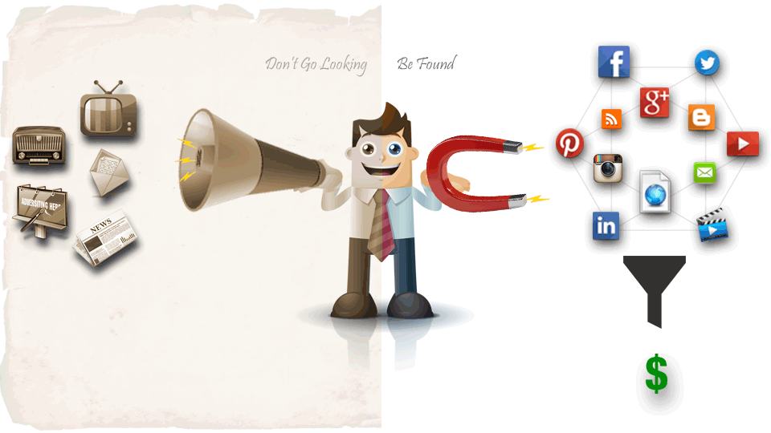
CONCLUSION
Digital Marketing is a very crucial activity in every business organization at recent times every services produced within an industry has to be marketed otherwise it will remain unused which will be of no value and digital marketing is the best and new way of selling the product/services faster and better.

