Slide 1
Malnutrition
Session 2 (msc cnd 2)
Smt Maniben M.P.Shah Women's College of Arts and Commerce/FC

Slide 2
Definition Of Malnutrition
Malnutrition refers to deficiencies, excesses or imbalances in a person’s intake of energy and/or nutrients. The term malnutrition covers 2 broad groups of conditions. One is ‘undernutrition’—which includes stunting (low height for age), wasting (low weight for height), underweight (low weight for age) and micronutrient deficiencies or insufficiencies (a lack of important vitamins and minerals). The other is overweight, obesity and diet-related noncommunicable diseases (such as heart disease, stroke, diabetes and cancer).
Smt Maniben M.P.Shah Women's College of Arts and Commerce/FC

Slide 3
Types Of Malnutrition
Malnutrition
Undernutrition
STUNTING
WASTING
Overnutrition
OBESITY
UNDERWEIGHT
NON COMMUNICABLE DISEASE
MICRONUTRIENT DEFICIENCIES OR INSUFFICIENCIES
Smt Maniben M.P.Shah Women's College of Arts and Commerce/FC

Slide 4
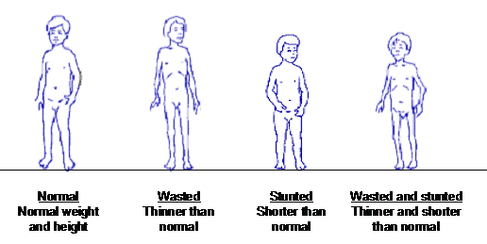
Smt Maniben M.P.Shah Women's College of Arts and Commerce/FC

Slide 5
Types Of Undernutrition
Marasmus
Kwashiorkor(Protein Energy Malnutrition)
Marasmus is a kind of malnutrition that occurs due to deficiency of proteins, carbohydrates and fats in the diet.
It’s more likely due to malnutrition for a short period.
Marasmus symptoms :- Weight loss, dehydration, stomach shrinkage, diarrhoea.
Treatment :- Providing a nutritious, well-balanced diet with lots of fresh fruits and vegetables, grains, and protein. Especially adding Vitamin B to the diet.
Kwashiorkor is a kind of malnutrition. It is primarily caused due to insufficient intake of proteins.
It’s more likely due to malnutrition over a long period.
Kwashiorkor symptoms :- Inability to gain weight, oedema or swelling of hands and feet, stomach bulging.
Treatment :- Providing carbohydrates followed by high protein foods. Dried milk specially.
Smt Maniben M.P.Shah Women's College of Arts and Commerce/FC

Slide 6
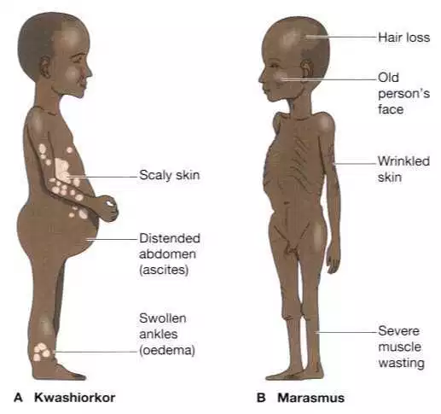
Smt Maniben M.P.Shah Women's College of Arts and Commerce/FC

Slide 7
Complications Of Malnutrition
Paleness
Tiredness
Headache
Lack of breath
Night blindness
Eye dryness
Eye ulcers
Goitre
Enlarged neck
Smt Maniben M.P.Shah Women's College of Arts and Commerce/FC

Slide 8
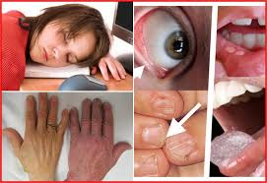
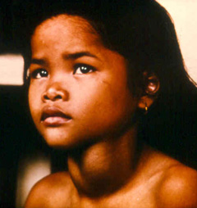
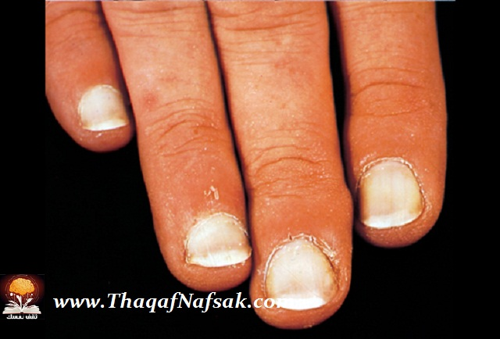
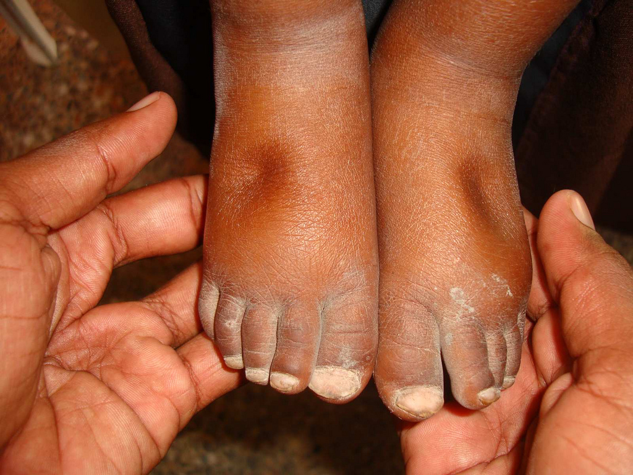
Smt Maniben M.P.Shah Women's College of Arts and Commerce/FC

Slide 9
CAUSES OF MALNUTRITION
Lack of presence of food
Poor quality of food
Presence of other disease
Increased dietary needs
Congenital (birth defects) which influence food intake
Ignorance of food, lack of education, emotional problems, poor habits, anorexia nervosa
Sanitation of food such as food contamination
Poverty
Smt Maniben M.P.Shah Women's College of Arts and Commerce/FC

Slide 10
Symptoms Of Malnutrition
tiredness and irritability
inability to concentrate
always feeling cold
loss of fat, muscle mass, and body tissue
higher risk of getting sick and taking longer to heal
longer healing time for wounds
higher risk of complications after surgery
depression
In more severe cases:
breathing becomes difficult
skin may become thin, dry, inelastic, pale, and cold
the cheeks appear hollow and the eyes sunken, as fat disappears from the face
hair becomes dry and sparse, falling out easily
Smt Maniben M.P.Shah Women's College of Arts and Commerce/FC

Slide 11
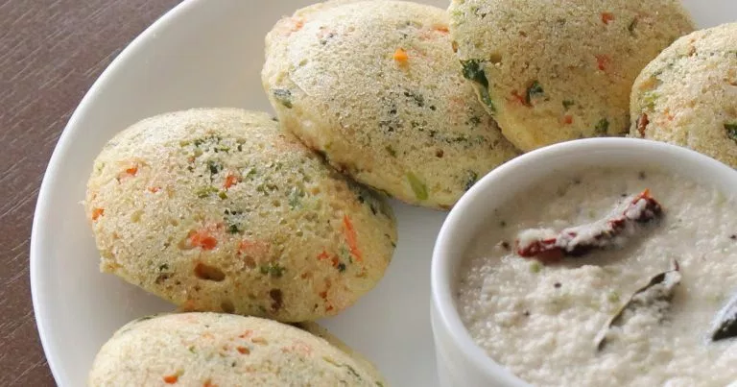
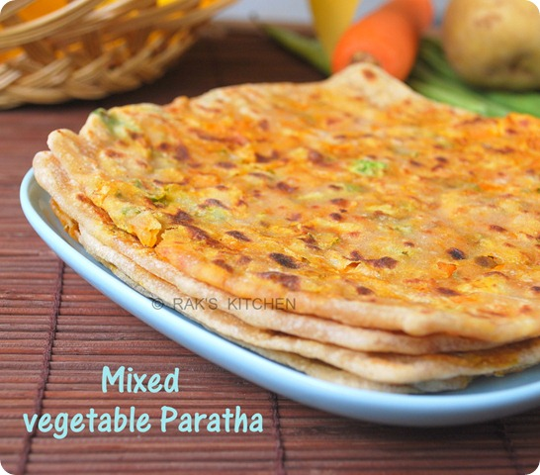
Dietary modifications
Carry carrot/cucumber/pomegranate/pear/banana/apple/guava with your tiffin box.
Add dry fruits in sandwiches, chapati roll(Franky), milk, etc.
Make chaats at home including corn, tomato, sprouts, kala chana, etc.
In the snacks you can have bhel, vetable idlis, dosa, sandwiches, paratha, etc.
Smt Maniben M.P.Shah Women's College of Arts and Commerce/FC

Slide 12
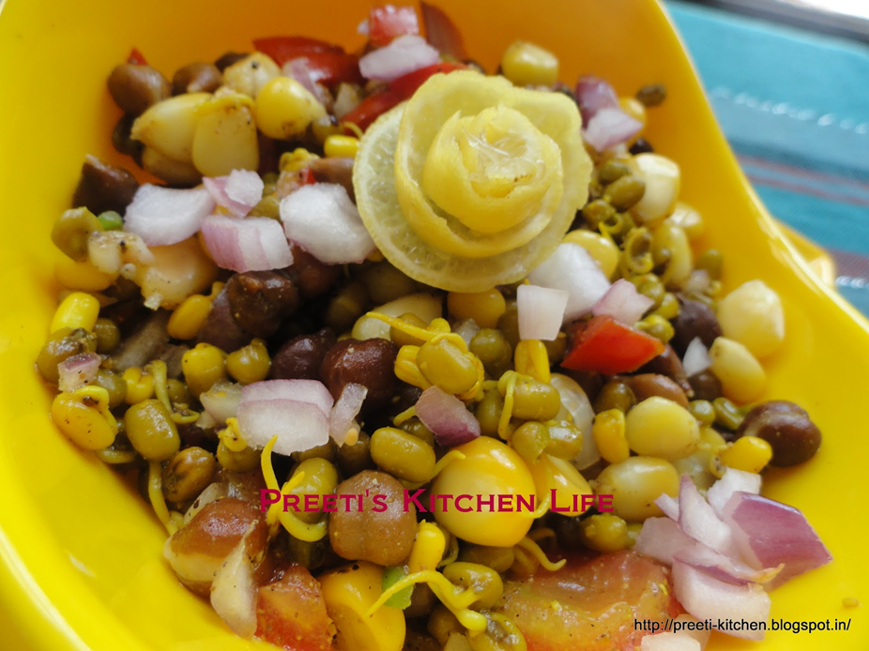
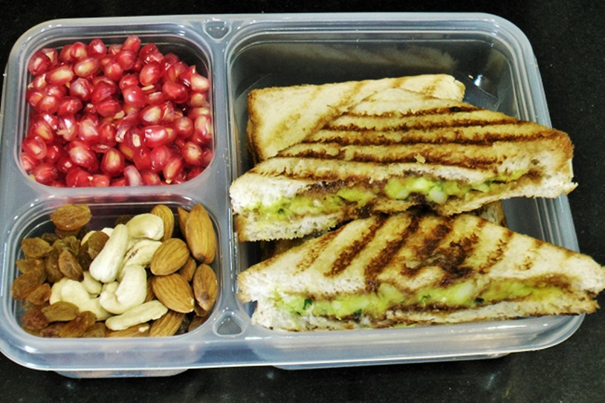
Smt Maniben M.P.Shah Women's College of Arts and Commerce/FC

Slide 13
PREVENTION
Having a good Balanced Diet every day by including all the food groups in your meal .
Eating varieties and colorful fruits and vegetables everyday to make your immunity more strong .
Consuming less amount of high fatty foods and sugary foods i.e processed foods.
Avoid drinking aerated drinks and drink at least 8 to 12 glasses of water everyday .
Regular exercise and being physically fit will help you to maintain your body weight.
Smt Maniben M.P.Shah Women's College of Arts and Commerce/FC

Slide 14
Smt Maniben M.P.Shah Women's College of Arts and Commerce/FC

